Slide 1
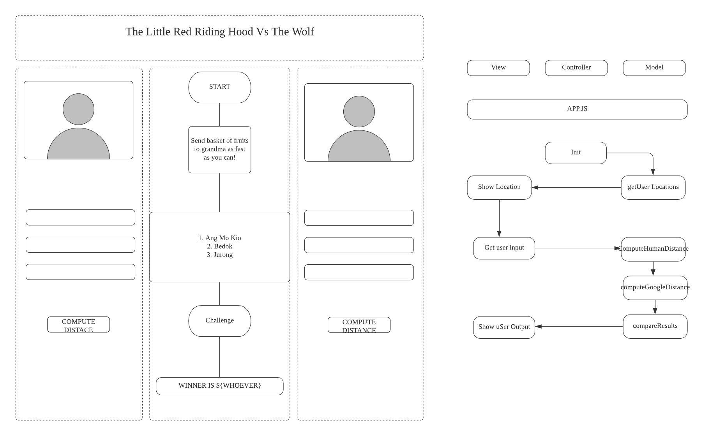

Slide 2
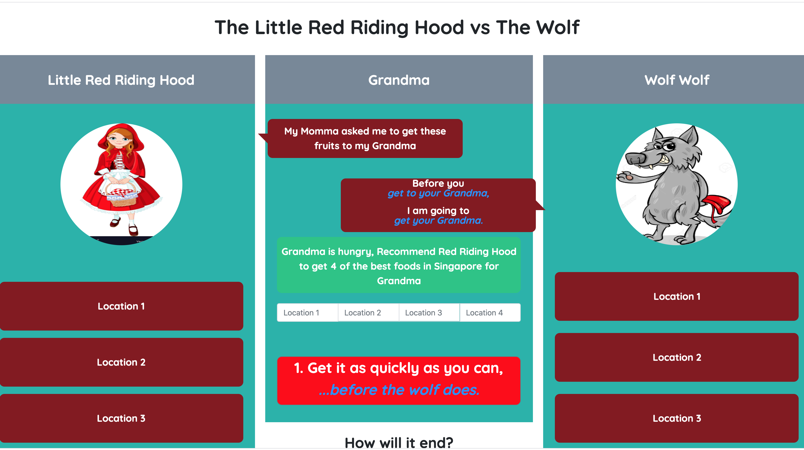

Slide 3
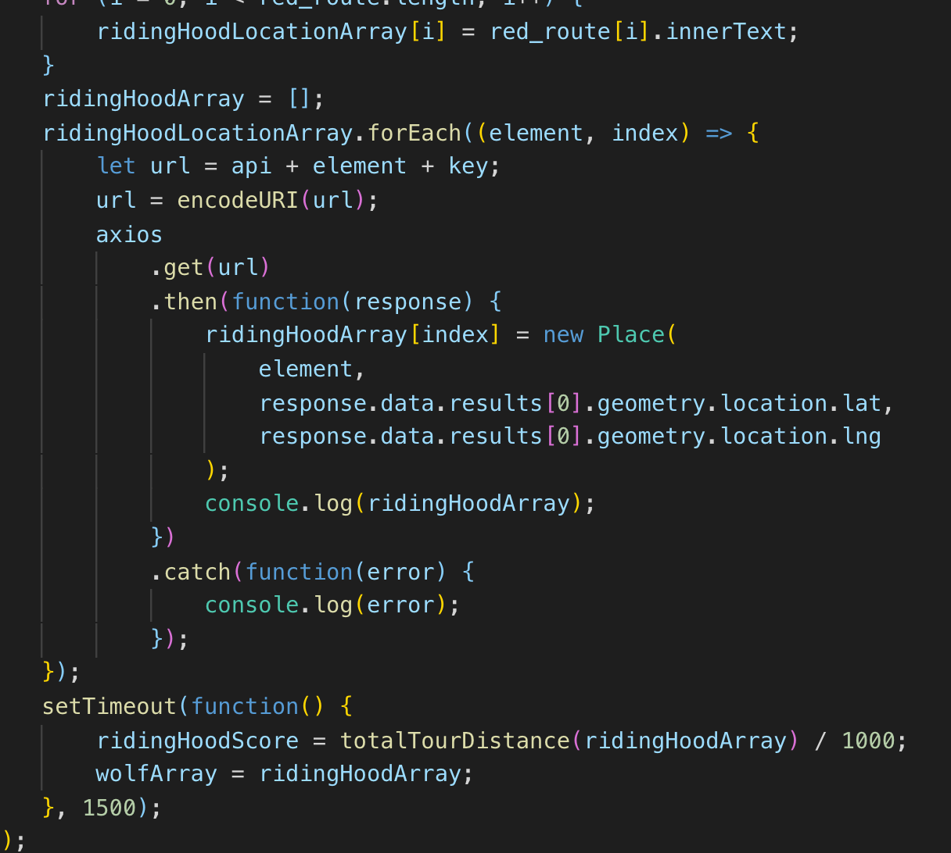
Challenges
Javascript async issue

Slide 4
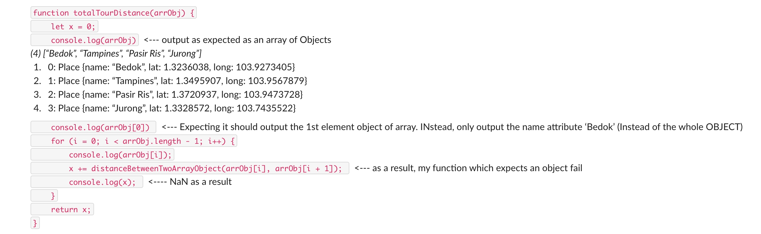
Challenges (2)
Do not re-use variables due to residual memory issue

